Slide 1
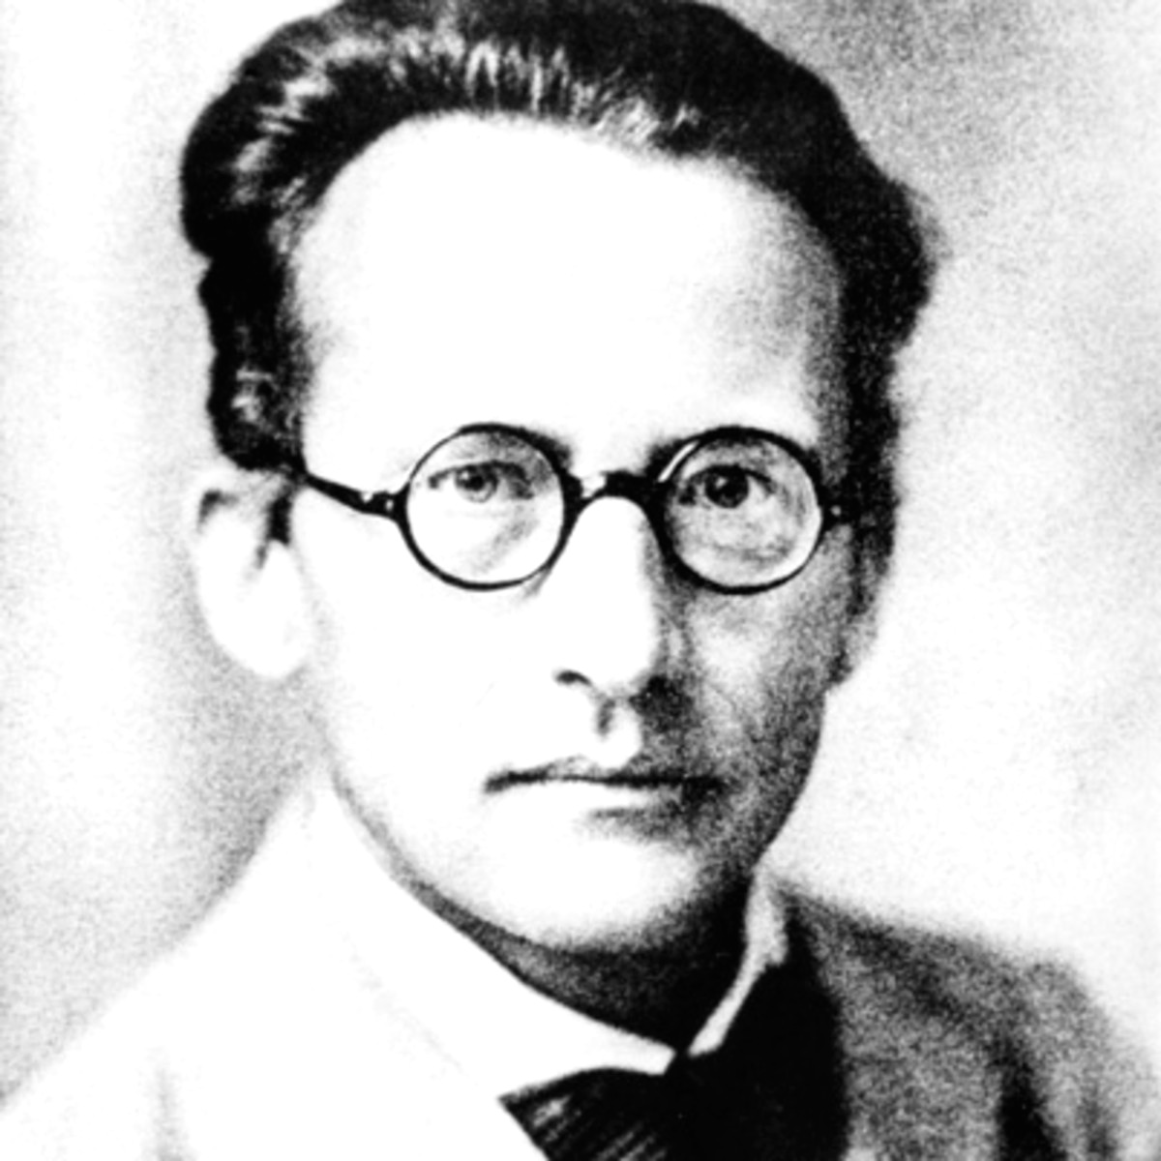
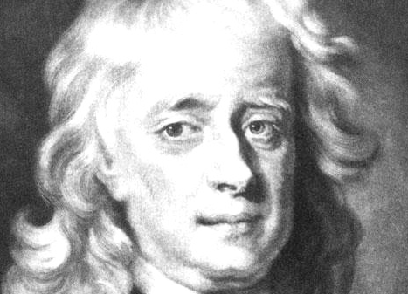



Linearized path integral methods for capturing quantum effects in MD simulations of condensed-phase systems
Eitan Geva
University of Michigan

Slide 2
Preliminaries
Fully quantum exact MD simulations via methods like MCTDH/QUAPI/HOEM/TT-SOFT, etc. are either limited to molecular systems with relatively small number of DOF or systems with simplified Hamiltonians (e.g. a few quantum states coupled to a harmonic bath).
Most systems of chemical interest are close to the classical limit and/or involve a few quantum DOF in a sea of classical DOF. Hence semiclassical or mixed quantum-classical.
Experimentally relevant measurable quantities (rates, spectra, etc.) can often be given in terms of reduced quantities like short-lived finite-temperature time correlation functions, which are more accessible, as well as more amenable for approximations, than the underlying many-body wave functions.

Slide 3
Do we really need all this info ???
Hamiltonian
Sampling
Feasible
shortcuts?
Averaging
Measurable quantities
(rate constants, spectra, etc.)

Slide 4
Preliminaries (Cont’d)
Wave functions are not the only way of doing quantum mechanics. Alternative representations of quantum mechanics (Feynman path integrals, Wigner, etc.) are often found to provide powerful platform for developing feasible, flexible, accurate and robust methods for simulating chemical dynamics.
Many methods used in practice are based on obtaining quantum effects from classical-like MD simulations.
The relationships between different methods is poorly understood, the approximations underlying different methods are not always clear and/or validated, and even if they are validated it is against a very limited set of benchmarks

Slide 5
How this state of affairs is related to “Modular Software Infrastructure for Excited State Dynamics” (or the current lack thereof)?
What is holding us back?
Scarcity of discriminative benchmark models and rigorous validation protocols.
Scarcity of excited state force fields and challenging nature of on-the-fly excited state electronic structure for realistic systems.

Slide 6
Perhaps not enough emphasis on the calculation of experimentally measurable quantities and not enough taking advantage of their reduced dimensionality?
Perhaps not enough taking advantage of finite and often relatively short memory times in condensed phase systems?
Unlike electronic structure, there appears to be no agreed upon clear hierarchy of methods and approximations that can serve as an unifying organizational guiding principle.

Slide 7
Proposition:
Can the linearized path integral approximation serve as such a unifying organizational guiding principle?

Slide 8
Linearized path integral - The basic idea

Slide 9
The Linearized Path Integral (also LSC) Approximation
The main contributions to the path integral come from forward-backward paths with small forward-back action.
The LSC approximation corresponds to linearizing the forward-backward action with respect to the difference between forward and backward paths.
A family of feasible, versatile and surprisingly accurate classical-like methods that can capture quantum effects in complex molecular systems.
A unifying platform: Different methods correspond to applying LSC to different quantities and/or different degrees of freedom.

Slide 10
Single PES Corr. Funcs.
CMD and RPMD
MultiplePES Corr. Funcs.
Classical Wigner
Linearize nuclear DOF
Linearize nuclear DOF
No well-defined classical limit!
LSC
Linearize nuclear
& electronic DOF
(Mapping H)
MQCL
Linearize nuclear DOF
Influence functional
Mapping H
Dynamics
Short-lived
inputs
GQME
TTM
Short-lived
inputs
Surface hopping
Ehrenfest and Symmetrical quasi classical (SQC)

Slide 11
Single PES Corr. Funcs.
Classical Wigner
Linearize nuclear DOF
LSC
Vibrational energy relaxation lifetimes in liquid solution

Slide 12
Vibrational energy relaxation rate constant
The relaxing mode
Remaining DOF
(translations,
rotations,
Vibrations)
Bath
induced
force
Forward-backward propagator
Quantum Force-force correlation function
Landau-Teller, Redfield quantum master equation, FGR

Slide 13
Linearized semiclassical (LSC) approximation
(equivalent to LSC-IVR, Classical Wigner, Shi & Geva JCP 118, 8173-8184 )

Slide 14
Wigner for anharmonic systems via Local Hamonic Approximation (LHA)
Nonclassical sampling of initial positions and momenta
(imaginary-time PIMD)
Classical
dynamics
Vazquez, Navrotskaya & Geva J. Phys. Chem. A 114, 5682 (2010)

Slide 15
Neat liquid Oxygen and Nitrogen at 77K
Ka, Shi & Geva JPCA 109 5527 (2005), Vazquez, Navrotskaya & Geva JPCA 114 5682 (2010)
 | Oxygen | Nitrogen
Experiment
Classical
LSC
Why it works: high-frequency FT dominate by CF at short time
Liquid oxygen experiment: Faltermeier et al. CP 62 377 (1981).
Liquid nitrogen experiment: Brueck & Osgood CPL 39 568 (1976).
Potentials: Everitt, Skinnr and Ladanyi JCP 116 179 (2002).
Direct extrapolation (ansatz-free).

Slide 16
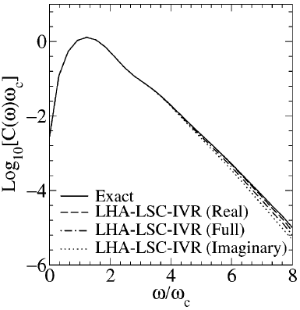
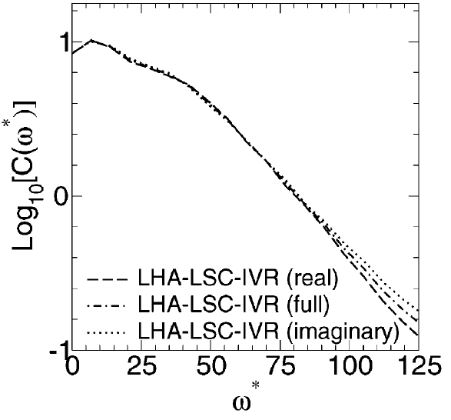
Detailed balance analysis (VER)
Diatomic solute in harmonic bath with coupling exponential in bath coordianates
A Diatomic Solute in a Monatomic L J Solvent (Breathing Sphere Model)
Shi & Geva JPCA 2003, 107, 9059-9069

Slide 17
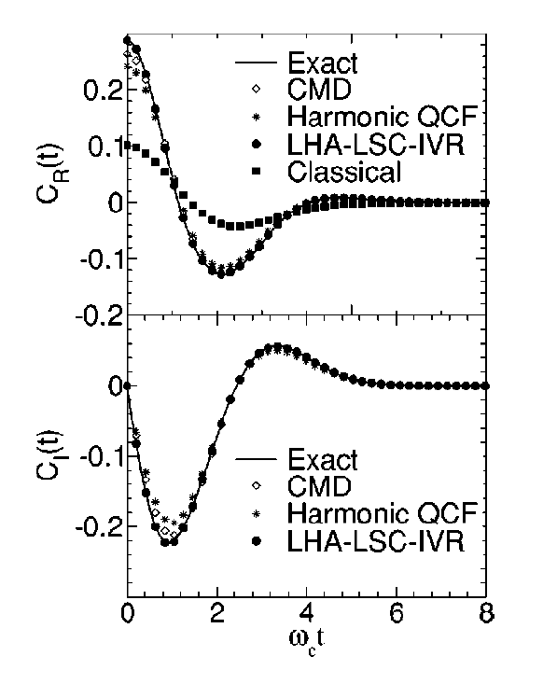
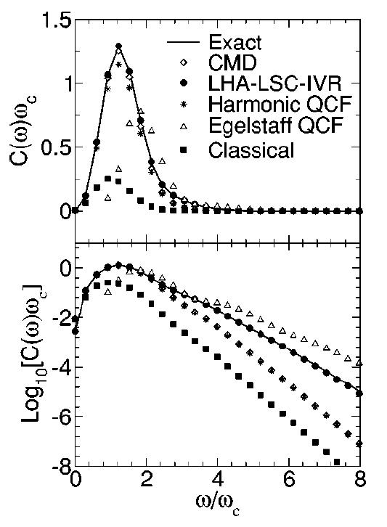
Force-force correlation function in the case of a force which is exponential in bath coordinates
Shi & Geva JCP 119 9030 (2003)

Slide 18
Single PES Corr. Funcs.
CMD and RPMD
MultiplePES Corr. Funcs.
Classical Wigner
Linearize nuclear DOF
Linearize nuclear DOF
No well-defined classical limit!
LSC
Linearize nuclear
& electronic DOF
(Mapping H)
Mapping H
Dynamics
MQCL
Linearize nuclear DOF
Influence functional
Short-lived
projector-free inputs
GQME
Short-lived
projector-free inputs

Slide 19
MultiplePES Corr. Funcs.
Linearize nuclear DOF
No well-defined classical limit!
LSC
Electronic population relaxation rates and optical response functions

Slide 20
Equilibrium FGR for electronic transitions
Energy

Slide 21
Shifted parabolas + Condon approximation
High temperature (classical nuclei) and short–time (transition state theory limit)

Slide 22
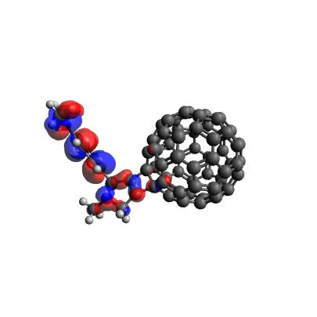
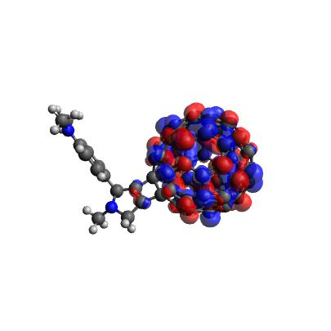
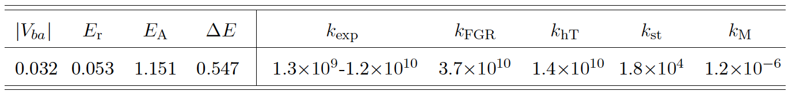
Hole transfer rate constant in C₆₀-(N,N-dimethylaniline)
(eV)
(s⁻¹)
Fully ab-initio:
TDDFT (BNL) + PCM(SWIG) + FCD (Qchem 4.0)
Lee et al. JPC C 117, 23391-23401 (2013)

Slide 23
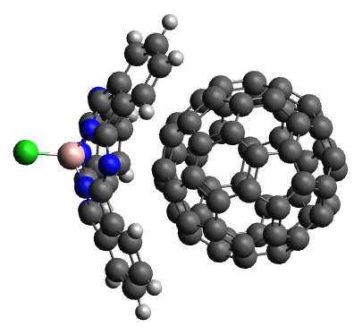
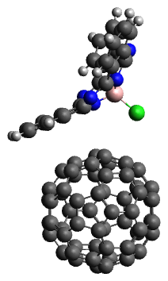
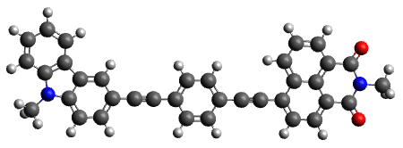
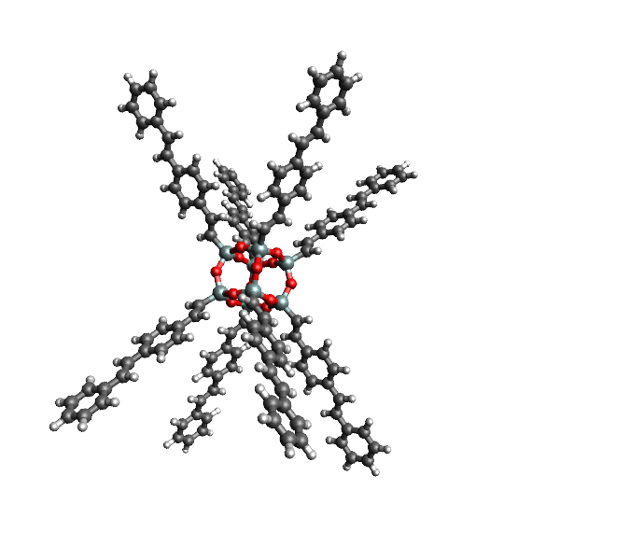
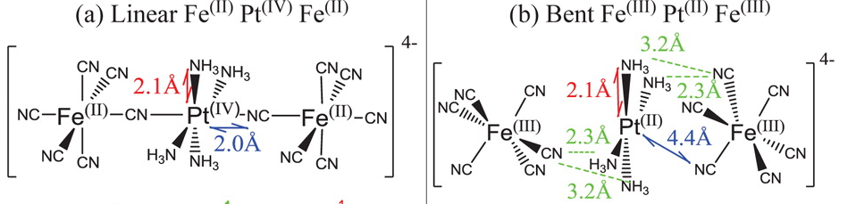
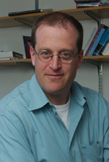
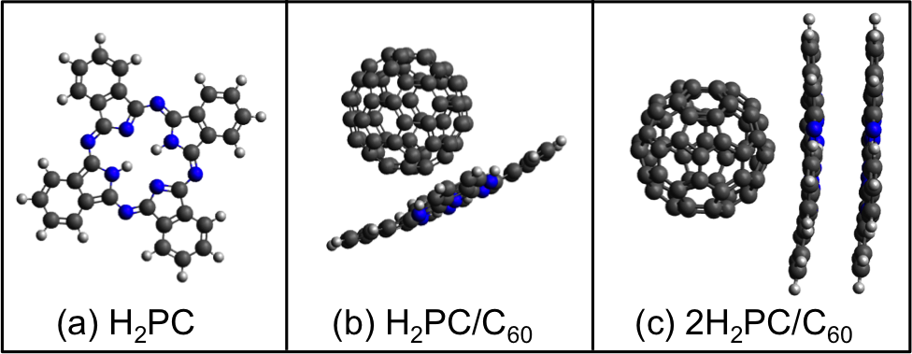
Hollow
phenylacetylene-bridged carbazole-naphthalimide
Bridge
Para
On top
Donor
Acceptor
Boron subphthalocyanine chloride - C₆₀
Functionalized silsesquioxanes
Prof. Barry Dunietz Kent State University

Slide 24
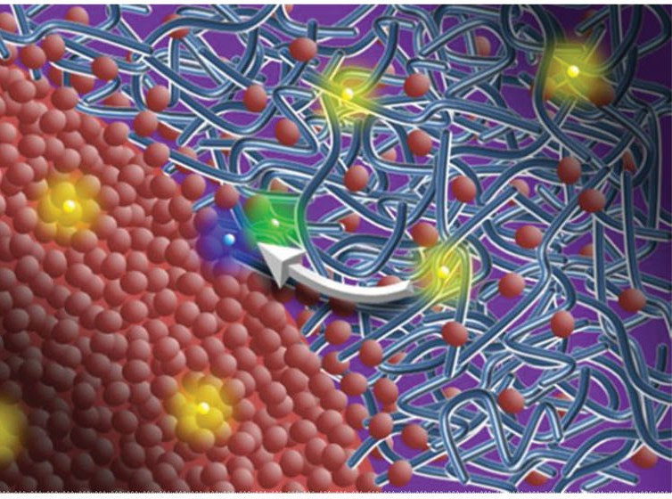
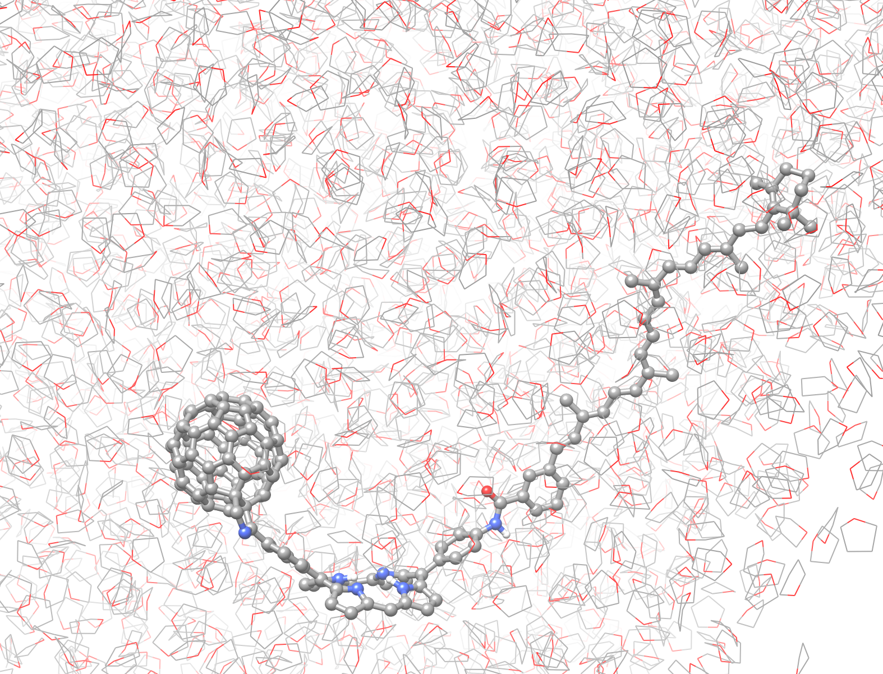
But what if the system is complex (liquids solution, OPVs) and thereby most naturally modeled via MD simulations governed by anharmonic force fields?
Map onto effective harmonic Hamiltonian by assuming linear response to obtain the spectral density from MD simulations.
A linearized path integral method that calculates FGR rates from MD simulations in a DIRECT manner and is guaranteed to yield the EXACT QUANTUM rate when the Hamiltonian is harmonic!
Organic photovoltaic device
https://phys.org/news/2013-01-path-efficient-solar-cells-uncovered.html

Slide 25
Equivalent quantum-mechanical expressions | Different “classical limits”
Sun & Geva J. Phys. Chem. A 2016, 120, 2976−2990

Slide 26
Linearized path integral approximation
Rigorously derived unambiguous classical-like limit.
Despite being classical-like, still reproduces the EXACT QUANTUM FGR for shifted parabolas model + Condon approximation (the Marcus paradigm).
Shi & Geva, JPCA 108, 6109 (2004)
Sun & Geva JCP 144 244105 (2016) JPCA 120 2976−2990 (2016)

Slide 27
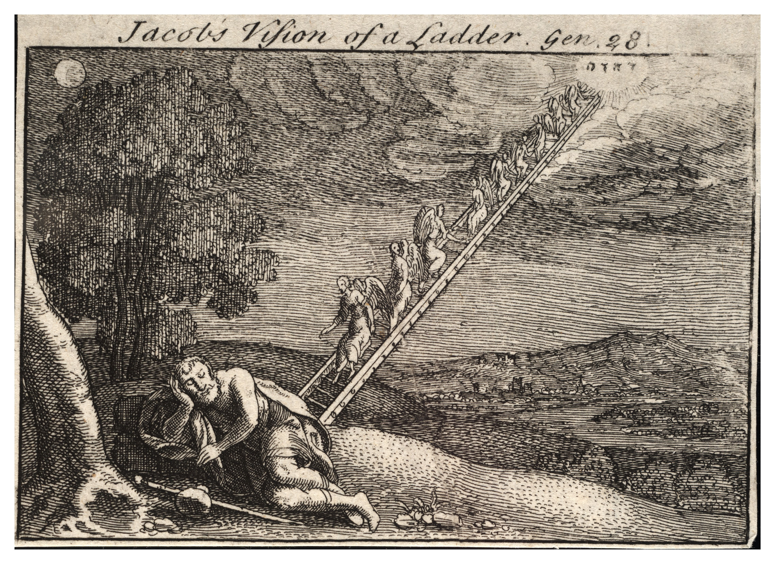
Jacob ladder of FGR approximations for electronic transitions
Quantum-mechanically Exact
Linearized path integral
Drop Wigner sampling
Replace average PES with D PES
Drop dynamics (TST-like)
Drop Wigner sampling and dynamics
Drop Wigner sampling ,dynamics and 2nd order cumulant expansion

Slide 28
Eq. FGR rate constants for electronic transitions through conical intersections
Izmaylov et al JCP 135 234106 (2011)
Sun & Geva JCP 144 244105 (2016)

Slide 29
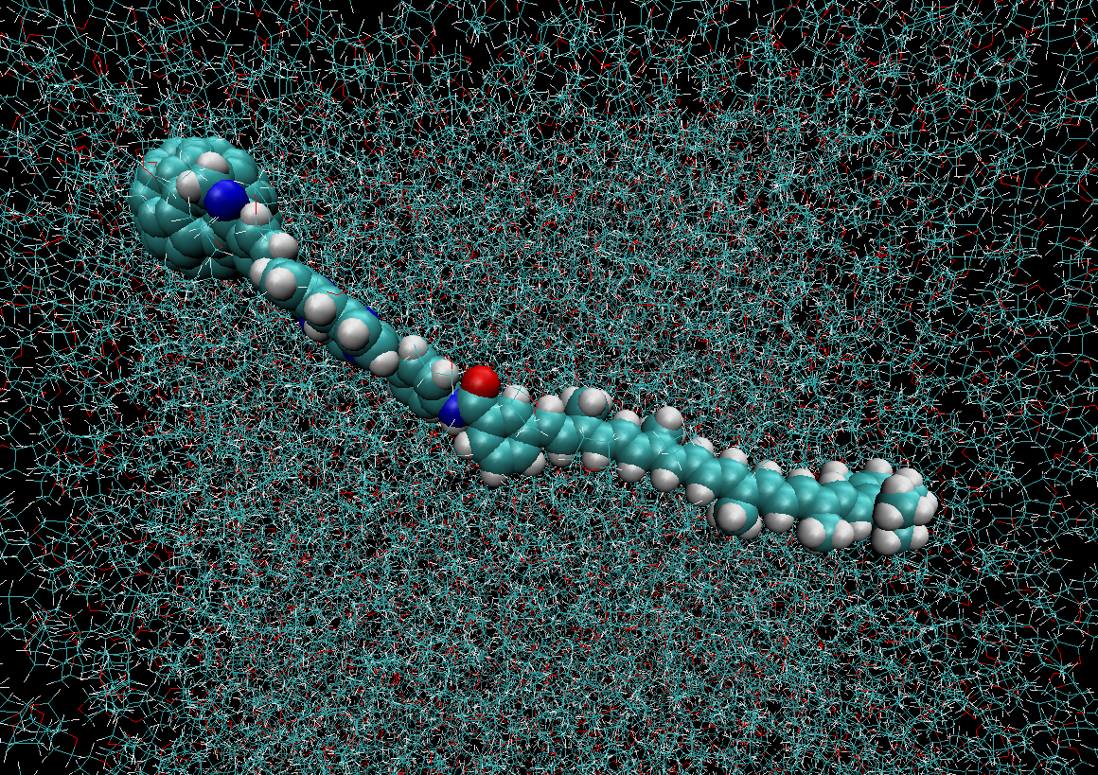
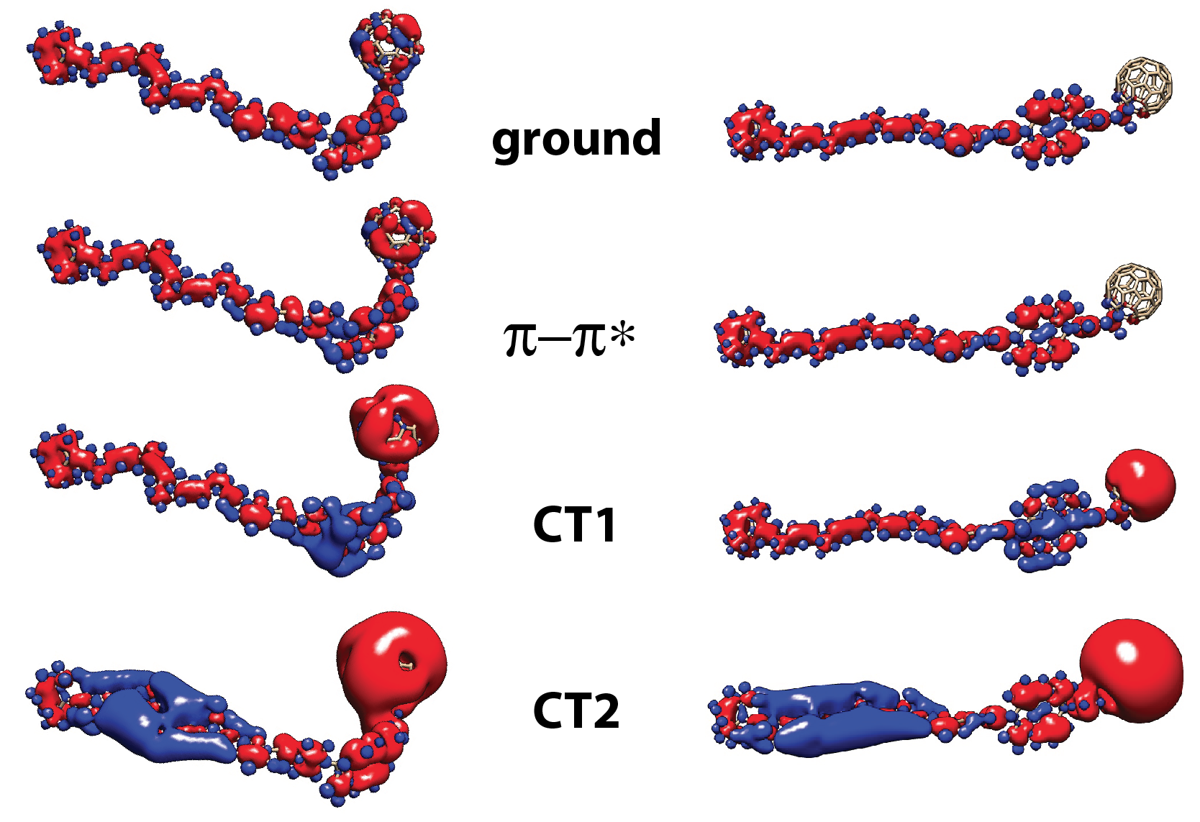
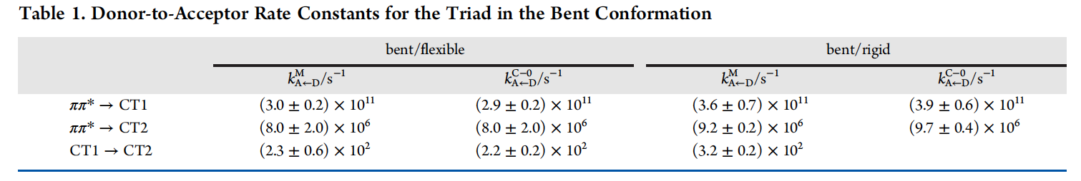
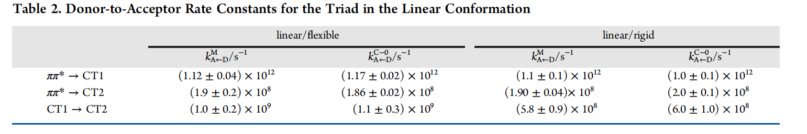
D-B-A Carotenoid-Porphyrin-C₆₀ Light-Harvesting triad in THF
Bent
Linear
Sun et al. JPC C, in press (2018) DOI: 10.1021/acs.jpcc.8b02697

Slide 30
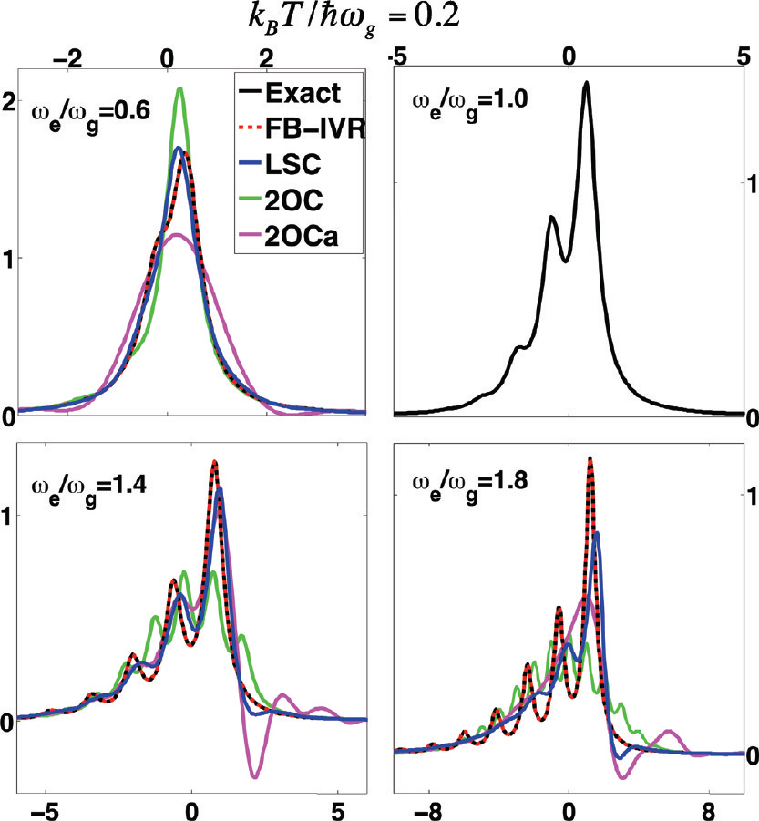
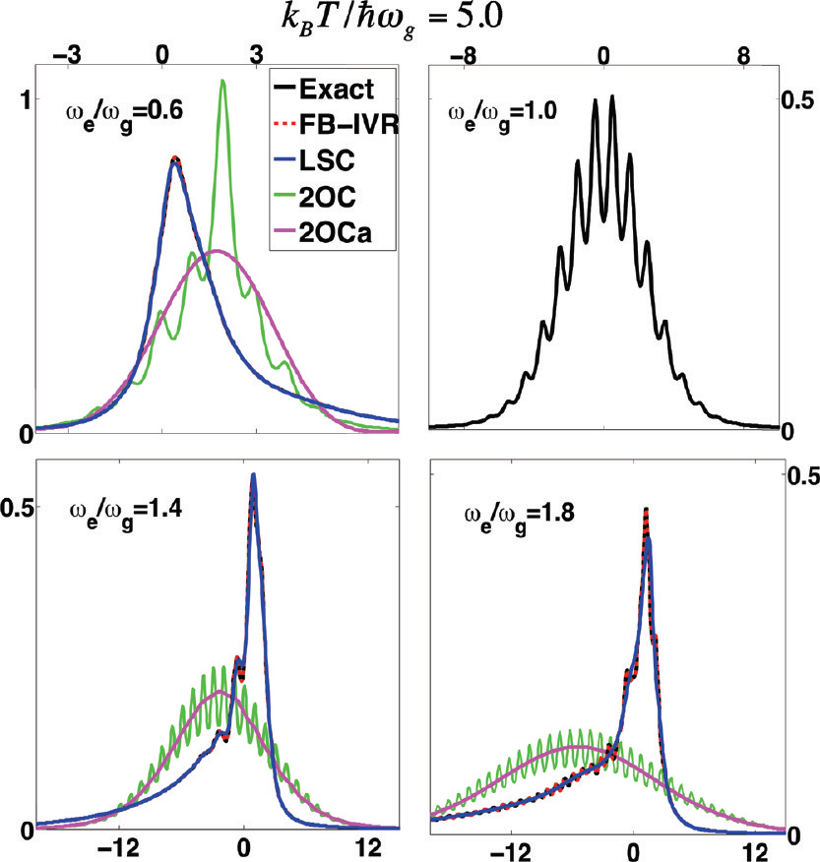
Linear spectra
McRobbie &Geva JPC A 2009, 113, 10425 (2009)

Slide 31
Nonequilibrium FGR
Nonequilibrium initial state
Dark CT
Ground
Coalson, Evans and Nitzan JCP 101 436 (1994)

Slide 33
Linearized path integral approximation for Noneq. FGR
Coincides with the EXACT quantum-mechanical for shifted parabolas model + Condon (the Marcus paradigm).
Noneq. FGR
Eq. FGR
Sun & Geva JCTC 12 2926−2941 (2016); JCP 145 064109 (2016)

Slide 34
Izmaylov et al JCP 135 234106 (2011)
Sun & Geva JCP 144, 244105 (2016)

Slide 35
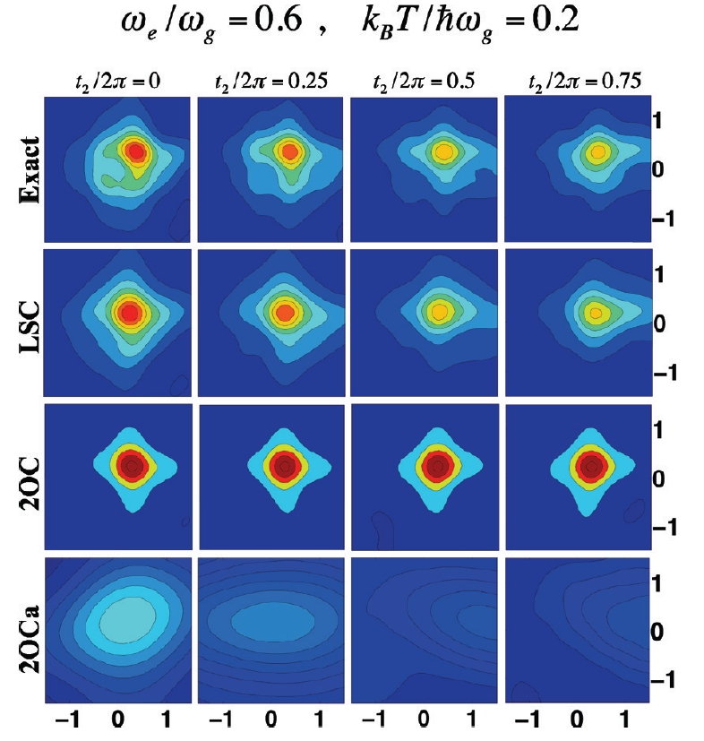
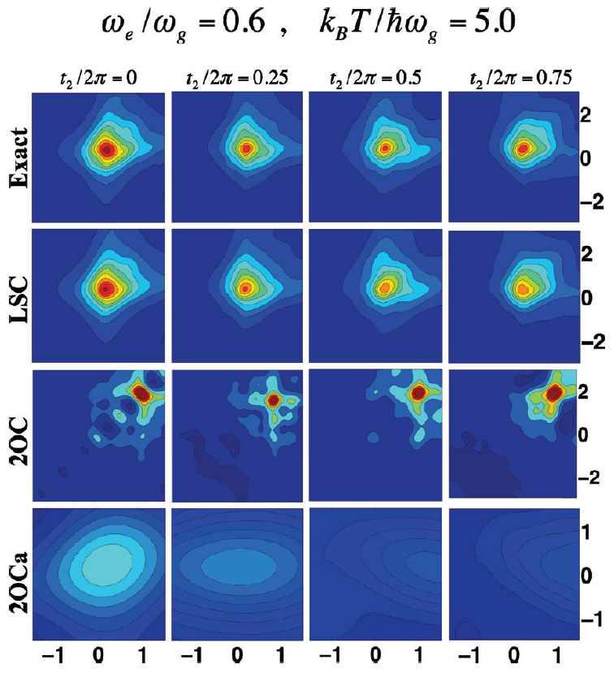
2D spectra (frequency resolved pump-probe)
McRobbie &Geva JPC A 2009, 113, 10425 (2009)

Slide 36
Single PES Corr. Funcs.
CMD and RPMD
MultiplePES Corr. Funcs.
Classical Wigner
Linearize nuclear DOF
Linearize nuclear DOF
No well-defined classical limit!
LSC
Linearize nuclear
& electronic DOF
(Mapping H)
Mapping H
Dynamics
MQCL
Linearize nuclear DOF
Influence functional
Short-lived
projector-free inputs
GQME
Short-lived
projector-free inputs

Slide 37
Going beyond FGR
Reduced quantum dynamics of system strongly coupled to bath
LSC
MQCL
Linearize nuclear DOF
Influence functional

Slide 38
Statement of the problem
Restrict the input on the bath
to the minimum required in
order to account for its effect
on the system

Slide 39
Assumption:
Exact isolated system quantum dynamics is accessible.
The influence functional contains all the input required to account for the effect of the bath on the system!

Slide 40
The influence functional is also a forward-backward path integral!
(that depends parametrically on the system forward-backward path)
Where there is forward-backward path integral, there is an LSC approximation!

Slide 41
The linearized influence functional
Coker, Makri,…

Slide 42
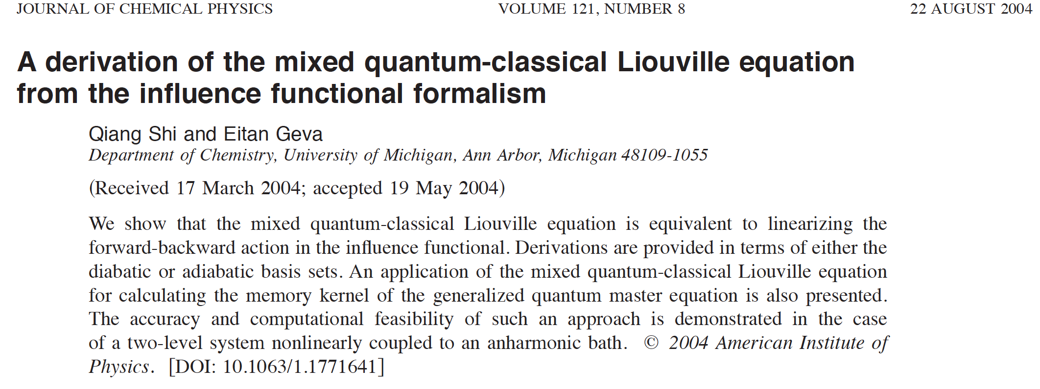
Linearization of the influence functional is equivalent to Mixed quantum classical Liouville dynamics
MQCL: Martens, Kapral & Ciccotti, Stock, Schofield, Coker,….
J. Chem. Phys. 121 3393 (2004)

Slide 43
Attractive features of MQCL
Rigorously derivable and systematically improvable “mixed quantum-classical” method.
Partial linearization with respect to bath only (system treated fully quantum mechanically!)→Mixed quantum-semiclassical.
Exact when system is linearly coupled to harmonic bath!
The influence functional is typically characterized by a relatively short memory-time in condensed phase systems. Thus, linearizing the short-lived influence functional(equivalent to MQCL) should yield an accurate description of the system relaxation at long times.
Formulated in terms of the density operator and Liouville space, treats populations and coherences on the same footing and accounts for both nonadiabatic transitions & dephasing/decoherence → ideal for simulating time-resolved spectra and photochemical processes.
Availability of algorithms for simulating MQCL dynamics in complex molecular systems (Martens, Kapral+Ciccotti+MacKernan, Stock, Schofield, Coker).

Slide 44
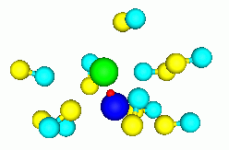
Nonadiabatic relaxation of the excited-state population of the H-stretch in a H-nonded complex dissolved in liquid MeCl
Hanna & Geva J. Phys. Chem. B 2008, 112, 4048-4058

Slide 45
LSC
MQCL
Linearize nuclear DOF
Influence functional
Short-lived
inputs
GQME
TTM

Slide 46
The computational cost of solving the MQCL equation grows rapidly with time, which limits the use of MQCL dynamics to rapid relaxation processes.
Generalized quantum Master equation (GQME) + MQCL
Shi & Geva: JCP 119 12063 (2003); 120 10647 (2004), 121 3393 (2004)
Zhang, Ka & Geva: JCP 125 044106 (2006), 125, 124509 (2006)
Reichman, Kelly & Markland,…

Slide 47
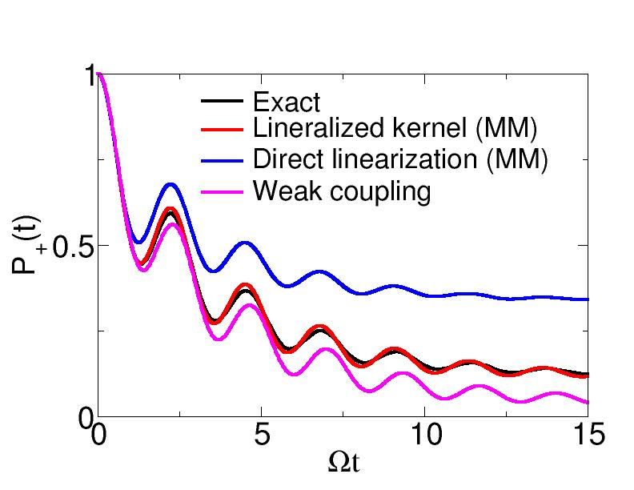
Spin-boson model
(MML approximation)

Slide 48
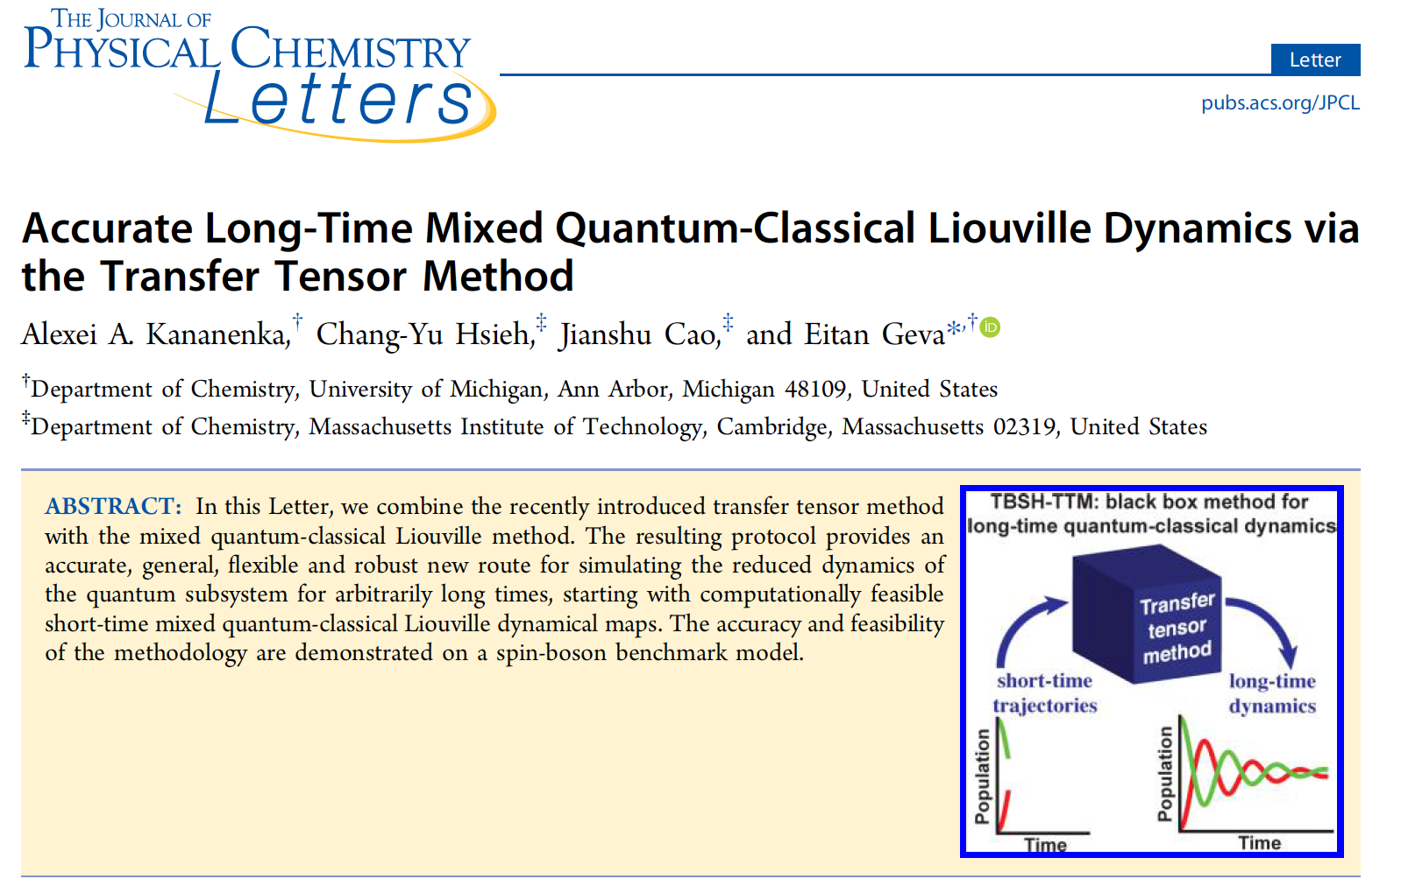
TTM: Cerrillo and Cao PRL 112 110401 (2014)
JPCL 7 4809−4814 (2016)

Slide 49
The Transfer Tensor Method (TTM)
Cerrillo and Cao PRL 112 110401 (2014)

Slide 50
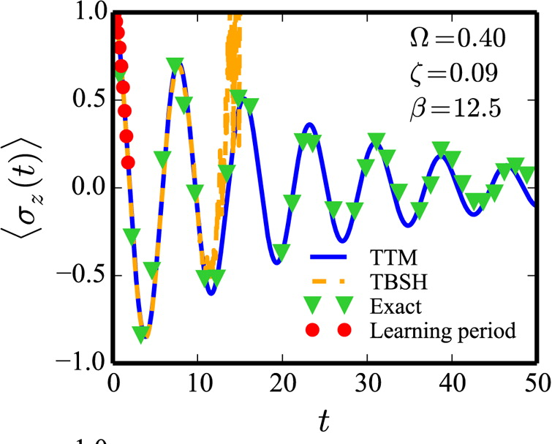

Slide 51
Single PES Corr. Funcs.
CMD and RPMD
MultiplePES Corr. Funcs.
Classical Wigner
Linearize nuclear DOF
Linearize nuclear DOF
No well-defined classical limit!
LSC
Linearize nuclear
& electronic DOF
(Mapping H)
MQCL
Linearize nuclear DOF
Influence functional
Mapping H
Dynamics
Short-lived
inputs
GQME
TTM
Short-lived
inputs
Surface hopping
Ehrenfest and Symmetrical quasi classical (SQC)

Slide 52


Acknowledgments
Prof. Barry Dunietz (Kent State University)
Prof. Margaret Cheung (University of Houston)
Prof. Qiang Shi (ICCAS, Beijing)
Prof. Gabe Hanna (University of Alberta)
Dr. Xiang Sun (NYU Shanghai)
Prof. Frank Vazquez (St. John’s University)
Dr. Porscha McRobbie (Wolfram)
Dr. Alex Kananenka (University of Chicago)
Dr. Alex Shubert (UM)
Ms. Ellen Mulvihill (UM)
Mr. Kyle Williams (UM)
Mr. Yifan Lai (UM)
Ms. Kristina Lenn (UM)
Ms. Yudan Liu (UM)

